Slide 1
BCP Council Holiday Activities and Food Programme 2021
Ann Van Dyke MBE
Consultant working on behalf of BCP Council

Slide 2
About me and my role
A track record of designing and delivering successful early years, play and family support policy, strategy and services
A ten year relationship with BCP Council(s)
Project start up in the short term
Supporting a management team at BCP Council to develop and embed our delivery
Facilitating partnerships

Slide 3
Our focus
School holidays can be pressure points for some families because of increased costs and reduced incomes.
Some children are more likely to experience ‘unhealthy holidays’ in terms of nutrition and physical health.
Some children from lower-income families are less likely to access fun activities.
Free holiday clubs are a response to this issue. They can work best when they provide consistent and easily accessible activities, for more than just breakfast or lunch.

Slide 4
What is it?
A free activity offer for 5 to 16s in receipt of benefits-related free school meals
4 hrs a day for 4 days a week over a week at Easter, 4 weeks in the summer and 1 week at Christmas
Includes a meal
Includes nutritional education
Is inclusive
Supports a mix of paying and free places (is non-stigmatised)
Links to other services

Slide 5
What it could look like
Holiday clubs (registered with Ofsted)
Youth clubs
Activity centres
Forest schools
School clubs
Creative clubs
Dance groups
Sports groups
A mix of face to face and virtual delivery

Slide 6
Local delivery
£1 million allocation
BUT approximately 8000 children in receipt of benefits-related free school meals
Tested the market at Easter
Now…
Learning what works for summer planning
Identifying and targeting need
Ensuring value for money and realistic place funding
Targeted support for families wrapped up in a universal offer
Infrastructure building
Getting creative

Slide 7
Our principles for delivery
Sustainability
Value for money – for every child
Linking up the funding (internally and externally eg Tax Free Childcare)
Not reinventing the wheel (so using the systems and processes we have already)
Partnerships add value
Pilot, monitor, review and improve
Inclusion must be business as usual
Specialist provision may be needed
We will maintain an ongoing dialogue with children, families and our providers to continually improve
FUN!!!

Slide 8
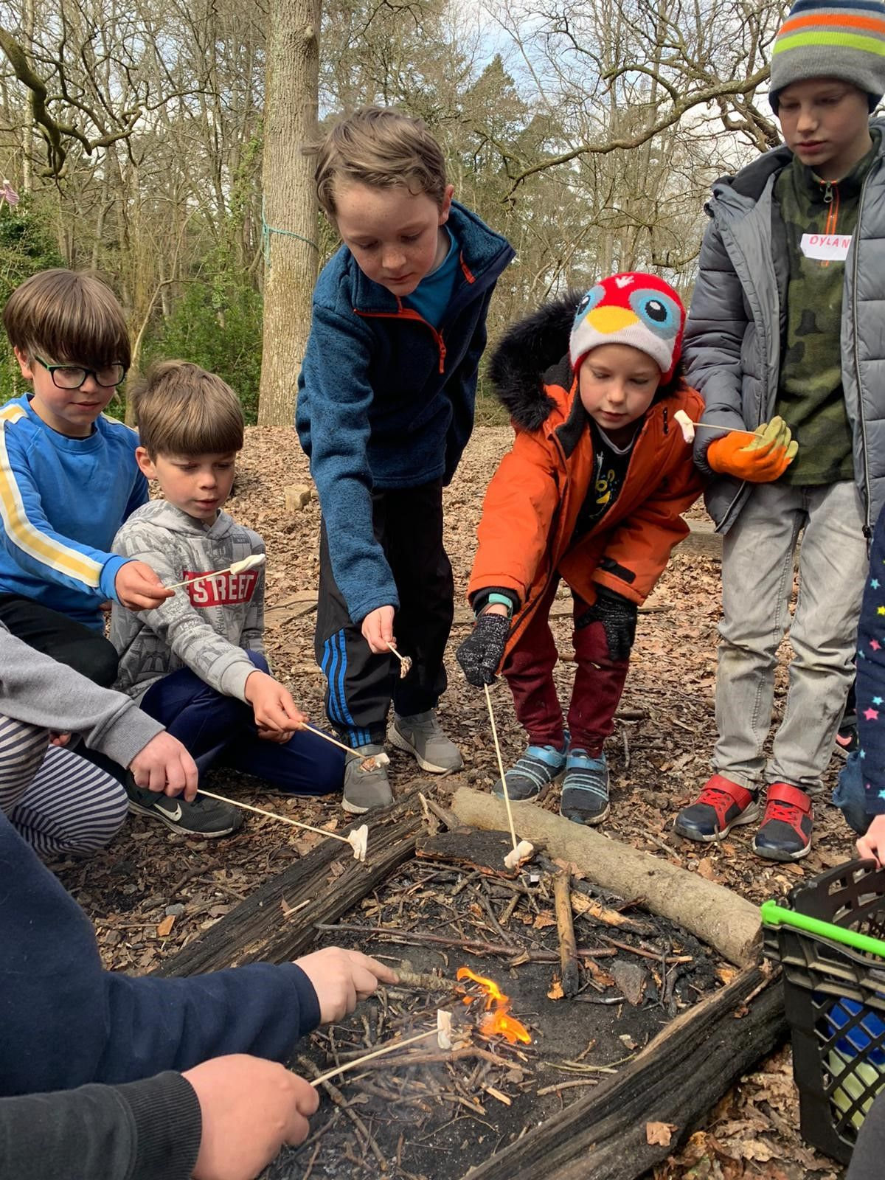
Our pilot offer at Easter
15 providers
1 virtual and 14 face to face
3382 places/meals (reaching approximately 1000 FSM children)
A range of activities
A range of age groups (5-16 years old)
Private, voluntary and community providers
All providing food and nutritional education
Please keep checking the HAF webpages as we are continually updating information to support you!

Slide 9
Headlines from our Easter pilot
2400 children attended activities (just over 1000 (41%) were in receipt of FSM)
On average FSM children accessed 6 sessions (6 x 4 hour sessions)
A range of enriching activities were delivered throughout the Easter pilot giving children the opportunity to develop new skills and try new experiences.
Activities delivered –
Nerf wars, mountain biking, trips out to the beach, different forms of dance,
den making, archery, football, yoga, gardening, tag rugby, dodgeball,
arts and crafts, parachute play, circus skills, easter egg hunt ….
Please keep checking the HAF webpages as we are continually updating information to support you!

Slide 10
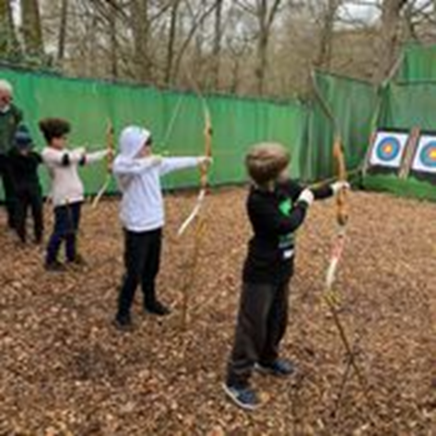
Headlines from our Easter pilot
Our providers said –
‘this pilot scheme has worked brilliantly’
‘It’s been good to get my teeth into something different, and I’ve liked it’
‘fully booked every day’
Our children said –
‘more people should come’
‘just want to come back’
‘had really good pumpkin pie – yummy, loved it.
Our parents said –
‘I like it because the children are safe’
‘It’s a help to working parents or wanting to find work’
‘The children have enjoyed the food at the club, they have come home and we had a picnic in the garden’
Please keep checking the HAF webpages as we are continually updating information to support you!

Slide 11
Our Summer Programme
Applications are welcome from across sectors NOW!
Places funded at a maximum of the charge being made to support sustainability, quality and diversity
A funding rate of £3.00 per child for the food element of the programme
Development cost may be supported to encourage expansion where needed
Added value will be scored highly
Partnerships are key
Identification, reach through positive promotion
Targeting our places to those most in need
Funding distributed 70% at the beginning and 30% following a return showing the actual number of take-up rate of places
A place is typically counted as one 4 four hour block and there is flexibility in how and when you deliver your places
Please keep checking the webpages as we are continually updating information to support you!

Slide 12
Our Summer Programme
Accept joint applications – partnering up with another provider
Timescales
Please keep checking the HAF webpages as we are continually updating information to support you!
Stage | Date
Applications open | 19.5.21
Deadline for applications | 9.6.21
Panel meeting | 14.6.21
Groups informed of decision | Week commencing 21.6.21 (with a fair wind!)
Funds distributed | Within one month of receiving paperwork (and the balance at the end of the summer).

Slide 13
What you can do…
Apply for funding to deliver and spread the word too!
Maximise funding and opportunities for children (our funding streams are a jigsaw puzzle!)
Develop partnerships and grow relationships locally
Consider how you can support us all in reaching our children and families with this amazing offer

Slide 14
What we will do…
Summer application process live and supported
Targeting our efforts to reach those who will benefit the most
Identifying and filling gaps where we can
Engagement with partners and brokering relationships
Supporting value for money and added value
Infrastructure support – what do you need next to support you?
Engaging and enriching activities
Nutritional food and whole family engagement in food education
Inclusive and welcoming opportunities
Sustainability in the longer term
Reach and take up by children and families
Contact HAF@bcpcouncil.gov.uk (emails will be forwarded so please bear with!)

Slide 15
Questions?
BCP Council HAF information
BCP Council HAF grant information
and application process
Contact HAF@bcpcouncil.gov.uk
Please keep checking the webpages as we are continually updating information to support you!

